Slide 1

SMART INDIA HACKATHON 2018
TEAM NAME: CODE SQUADS
TEAM ID: 17160
MEMBERS: P.RATNAKAR
D.SRIKANTH
V.SNEHA CHOWDARY
A.DIVYA
P.KUSARAJU
S.SRI CHARAN

Slide 2
ProblemStatement Title: Request for online nomination Statement: At present , for different training to be held in this directorate , request is made to all HODs of GNCT of Delhi, to forward the nominations. The request is in the form of circular issued through letters and e-mail. As such , nominations may be made through link to be available on the website on this Directory.
Solution : Our idea is to develop a website that can be accessed by the users and admin (management). The main theme of this website is to circulate the information between the users and admin. The admin can post the circulars regarding the different training sessions. The user can go through that circulars and send their nominations according to their field of interest. The admin can go through the nominations, verifies it and he will nominate the person through this website by sending a confirmation mail. The nominated person’s details will be updated in the training sessions list.

Slide 3
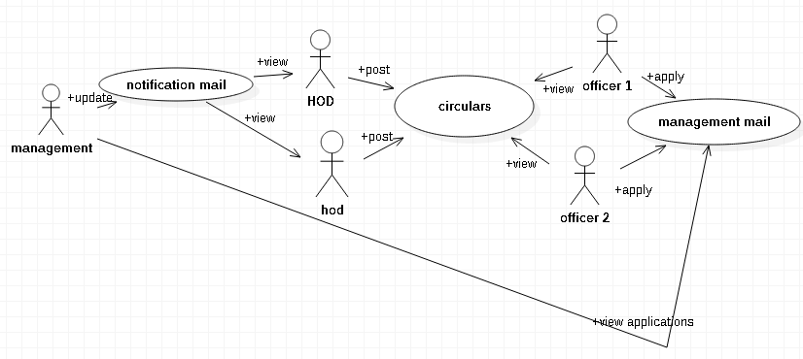
EXISTING SYSTEM

Slide 4
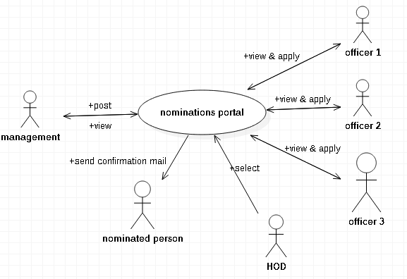
PROPOSED SYSTEM

Slide 5
TECHNOLOGIES STACK:
Ajax
PHP
HTML
CSS
Database used:
MySql

Slide 6
SCREEN SHOTS

Slide 7
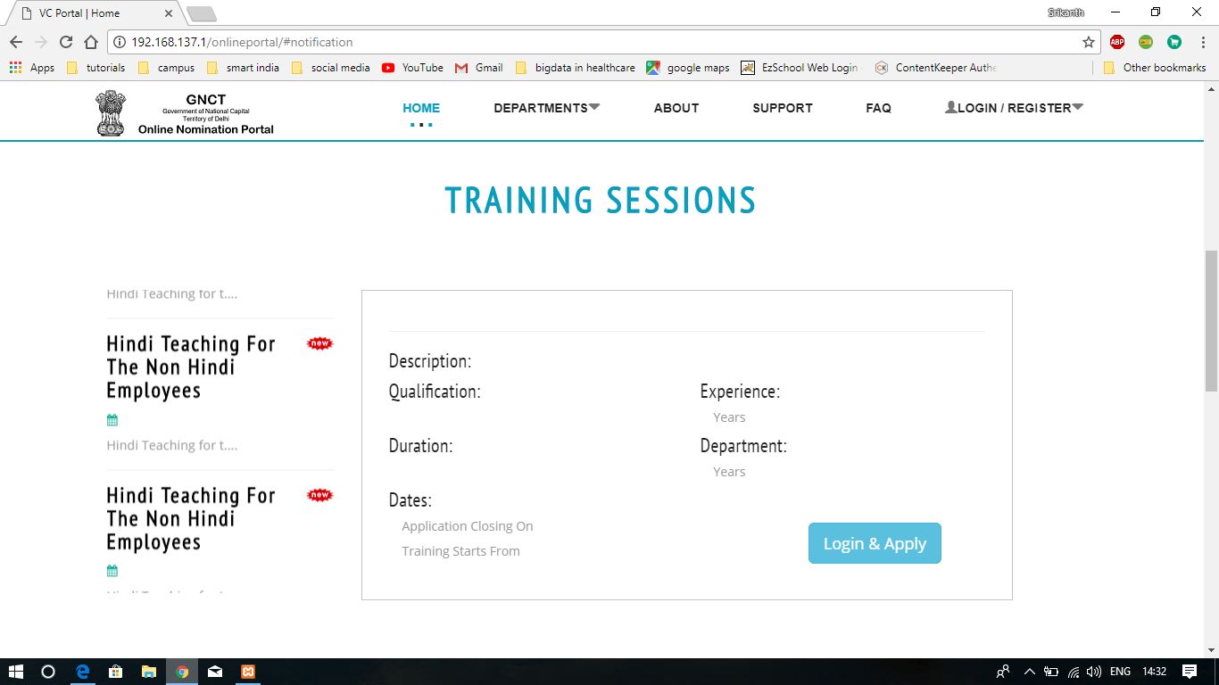
This page shows the list of all training sessions and their descriptions

Slide 8
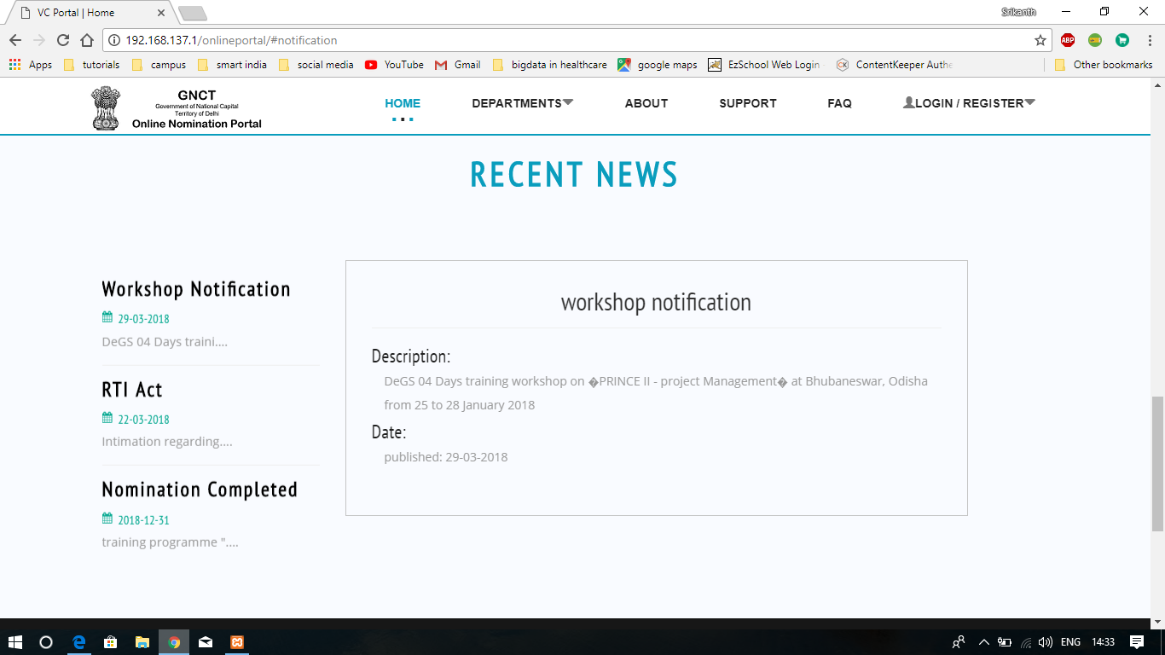
ALL RECENT NEWS WILL BE UPDATED HERE

Slide 9
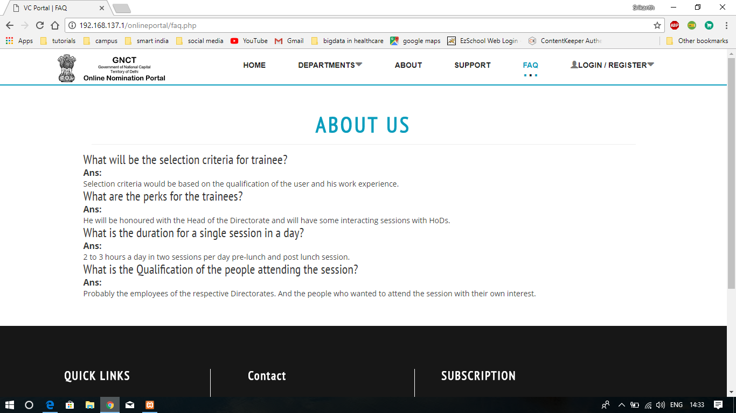
ABOUT THE WEBSITE

Slide 10
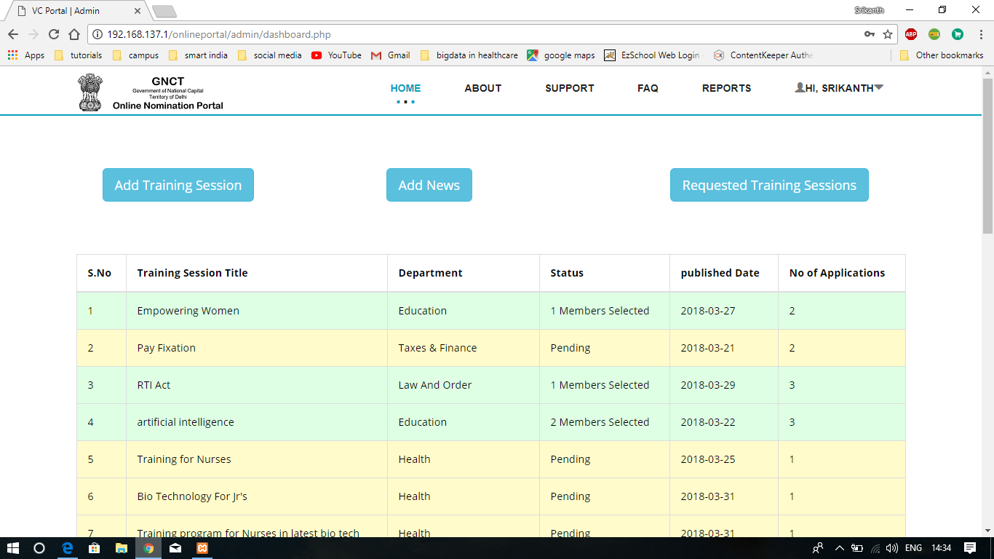
TRAINING SESSIONS PROVIDED FOR VARIOUS DEPARTMENTS AND THEIR DETAILS

Slide 11
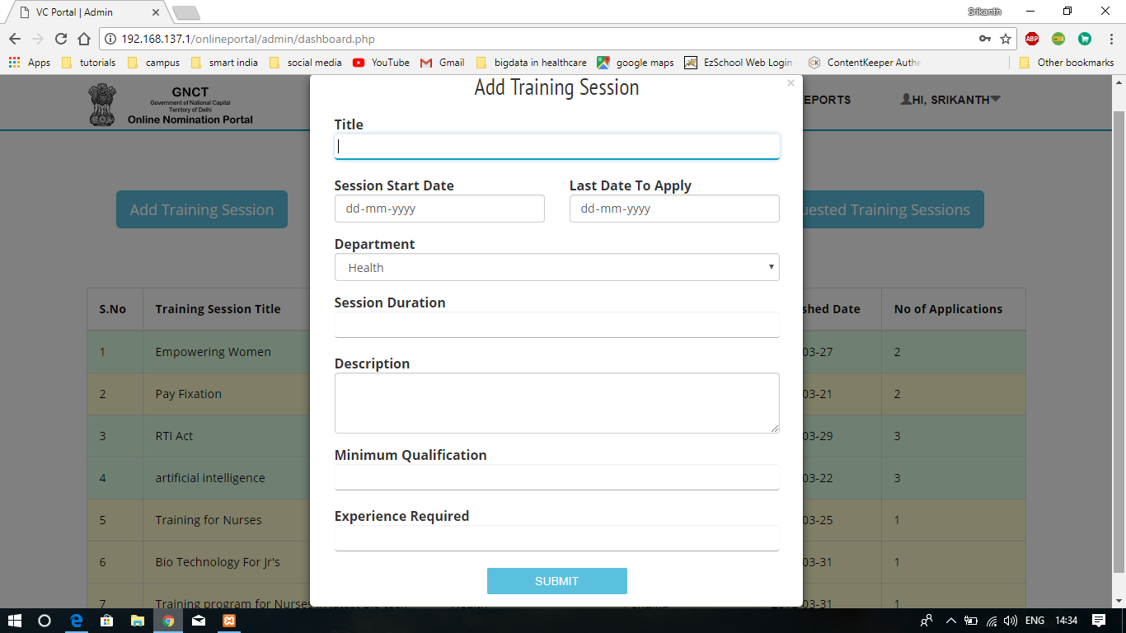
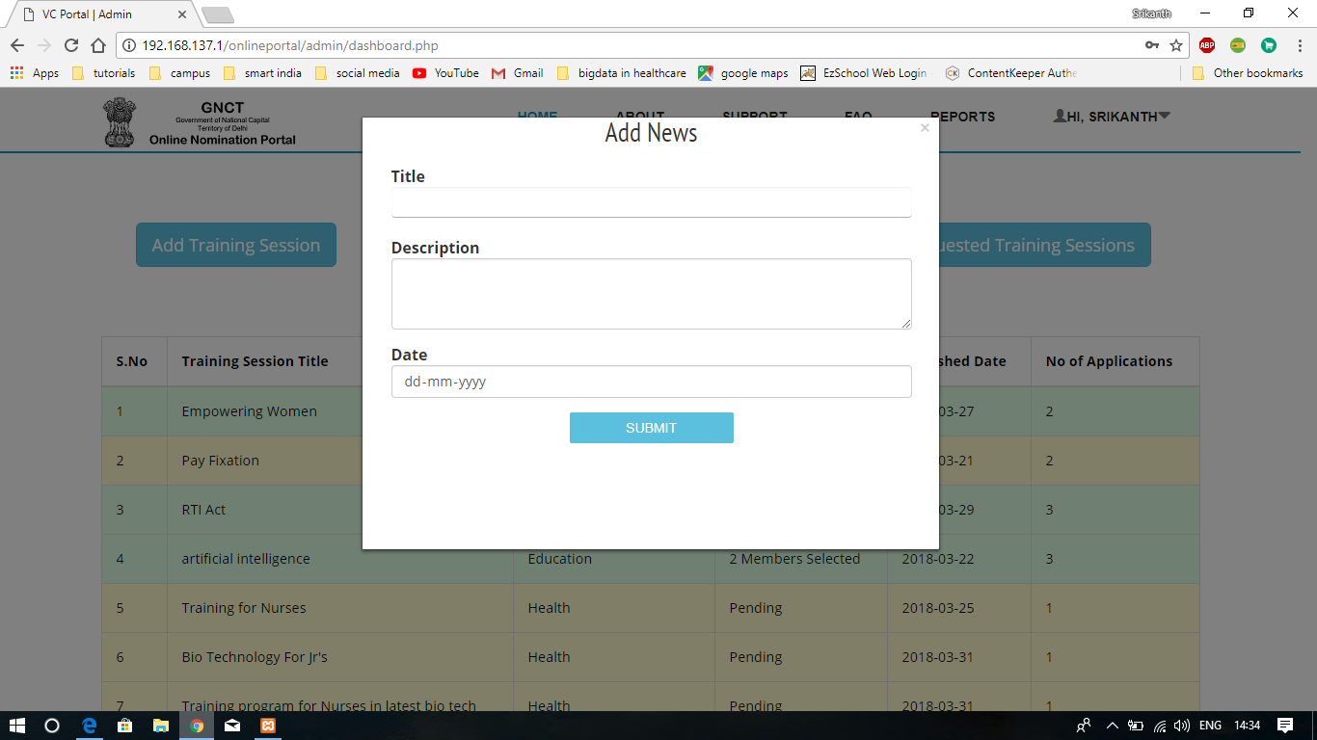
TO ADD NEW TRAINING SESSION AND NEWS

Slide 12
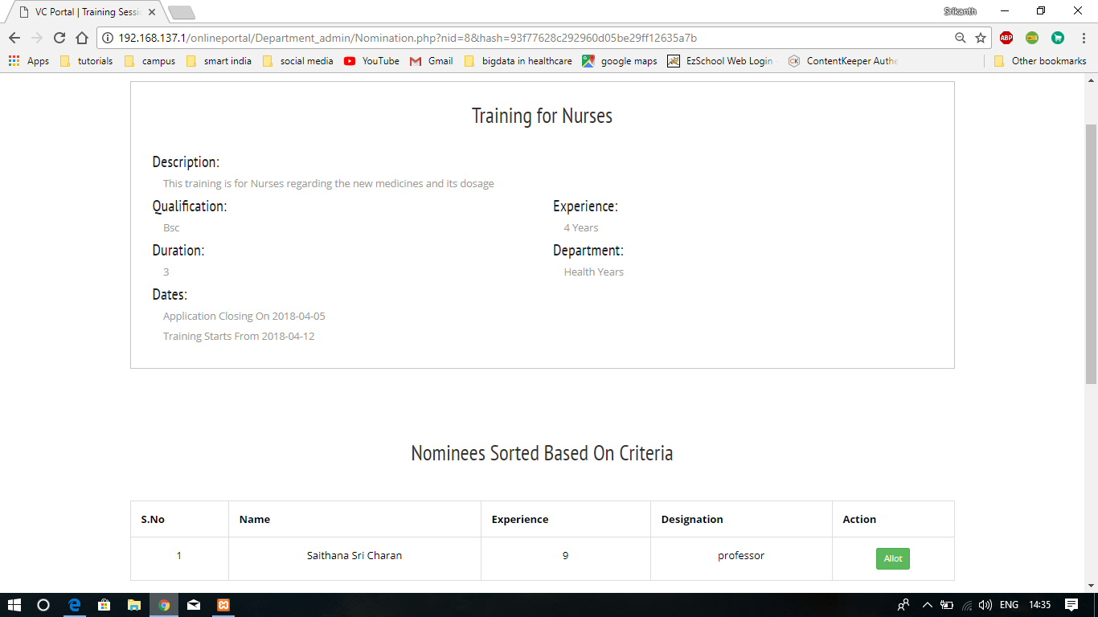
NOMINEES FOR A TRAINING SESSION

Slide 13
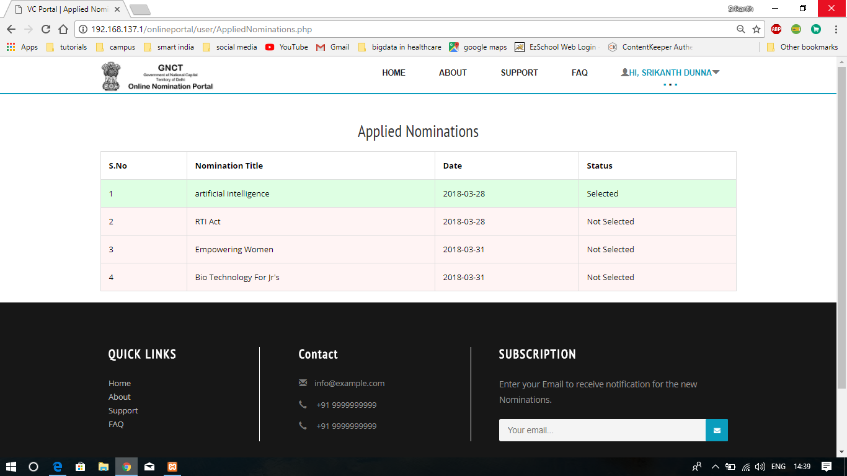
TOTAL NUMBER OF TRAINING SESSIONS A PERSON APPLIED FOR

Slide 14
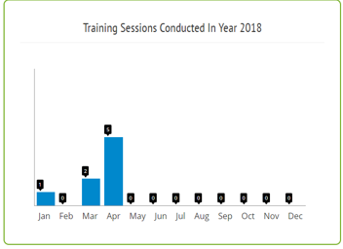
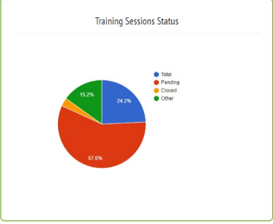
TRAINING SESSIONS CONDUCTED IN YEAR & THEIR STATUS

Slide 15
THANK YOU

